Slide 1
HackerCamp 2018
Analytics
Abhinav Jain
The LNM Institute of Information Technology
Contact : 15UEC003@lnmiit.ac.in
9530158018, 9571921420

Slide 2
PROBLEM
Variation in names leads to difficulty in identifying a unique person and hence deduplication of records is an unsolved challenge. The problem becomes more complicated in cases where data is coming from multiple sources. Following variations are same as Vladimir Frometa:
Vladimir Antonio Frometa Garo Vladimir A Frometa Garo Vladimir Frometa Vladimir Frometa G Vladimir A Frometa Vladimir A Frometa G
Train a model to identify unique patients in the sample dataset.

Slide 3
Approach
For doing this task I am using dedupe library in Python. It is based on machine learning which uses human labeled data to do the task of deduplication.
How it works -
It calculates Record Similarity by using string metric. String metrics returns low number if strings are similar and high if they are not. One string metric is Hamming distance. For example ‘innovacer’ and ‘Innovacer’ has hamming distance of 1 because we need to do one substitution and can convert to other.

Slide 4
Record by Record Approach-
first name | last name | address | phone | -------------------------------------------------------------- bob | roberts | 1600 pennsylvania ave. | 555-0123 | Robert | Roberts | 1600 Pensylvannia Avenue | |
record_distance = string_distance('bob roberts 1600 pennsylvania ave. 555-0123','Robert Roberts 1600 Pensylvannia Avenue')
Field By Field Approach-
record_distance = (0.5 * string_distance('bob', 'Robert') + 2.0 * string_distance('roberts', 'Roberts') + 2.0 * string_distance('1600 pennsylvania ave.', '1600 Pensylvannia Avenue')+ 0.5 * string_distance('555-0123', ''))

Slide 5
Field by field approach is good as we can express the importance of fields by numeric weights.
Then Regularized Logistic regression can be used to best estimate the probability that set of records are duplicate or not.

Slide 6
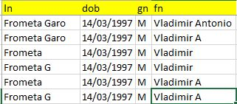
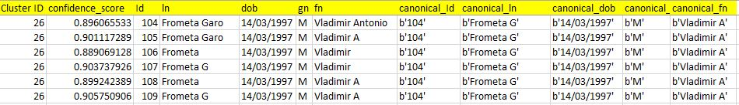
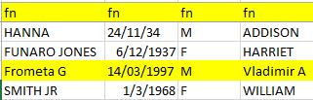
ISnapshot of Input , Intermediate Output and Final Output . Intermediate Output shows how different entries belong to the same cluster in our data set. ‘Belonging to the same cluster means that they are duplicates of each other and hence they are referring to single entry.

